Slide 1

good practice in sustainable urban freight transport
8 August 2019
Ian Wainwright
Director, Future City Logistics (on behalf of Smart Freight Centre)

Slide 2
Smart Freight Centre
Smart Freight Centre is a global non-profit organization working towards an efficient and low emission freight sector that contributes to staying within Paris Agreement targets.
We bring the global logistics community together to drive transparency and mobilize multinational companies and their logistics partners to take action:
    Develop global industry guidelines and approaches
    Advocate for industry-wide adoption and aligned government policy
    Support businesses to calculate, report and reduce emissions
    Recognize Smart Freight Leaders
50% world’s population is urban, addressing Urban Freight is vital for decarbonisation
http://www.smartfreightcentre.org/

Slide 3


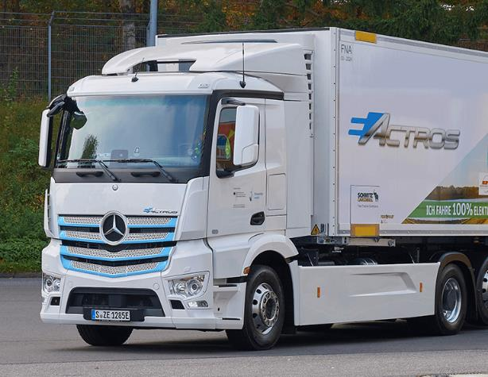
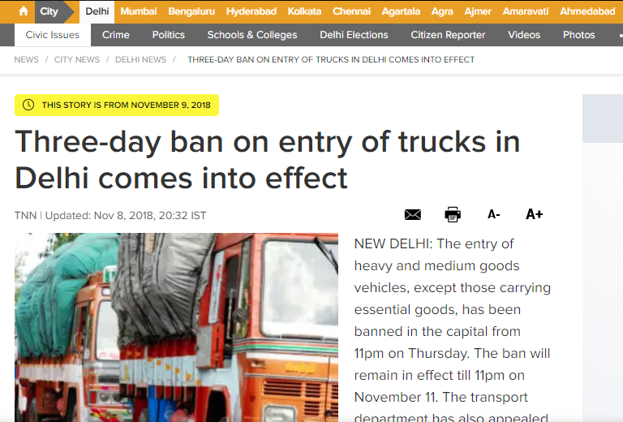
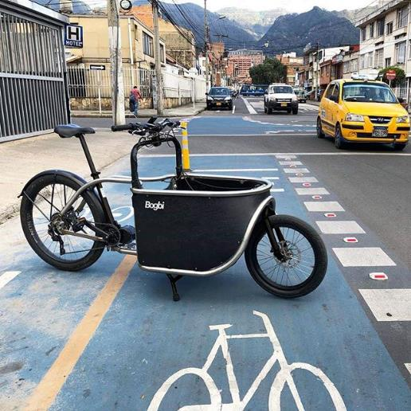
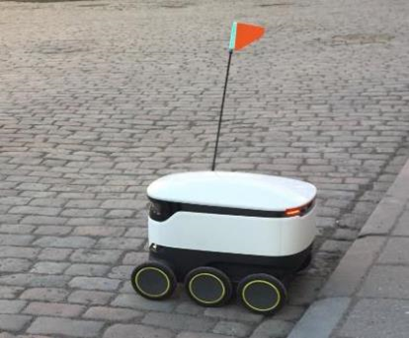
Sustainable freight solutions exist …

Slide 4
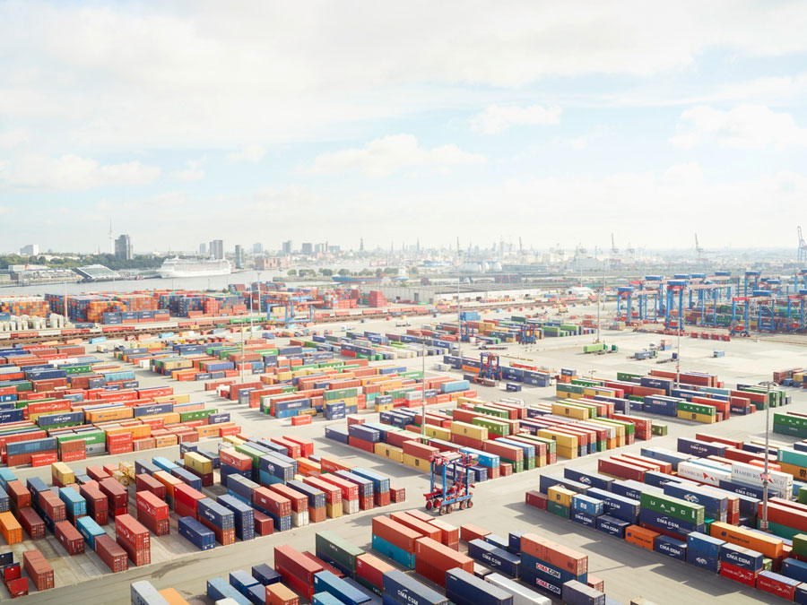
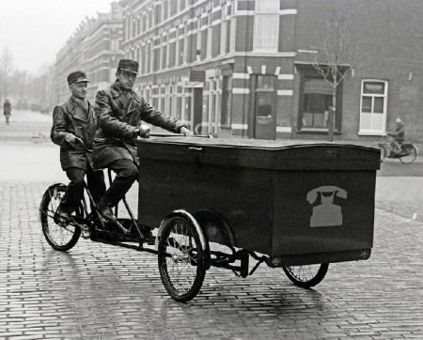
… but a lack of understanding?
© Henrik Spohler

Slide 5
Understanding good practice

Slide 6
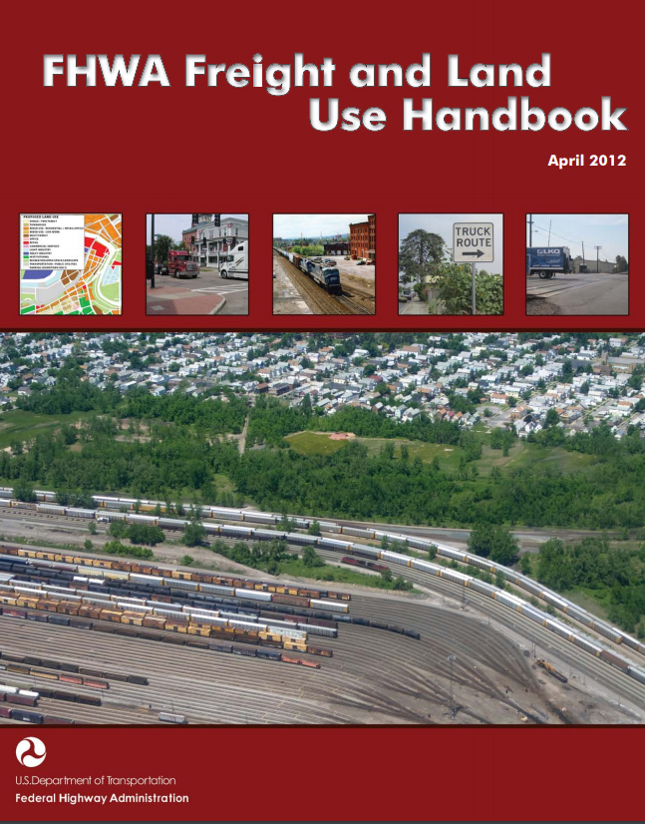
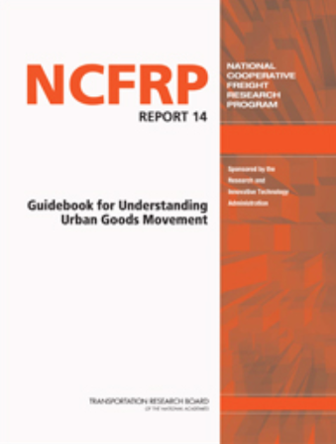
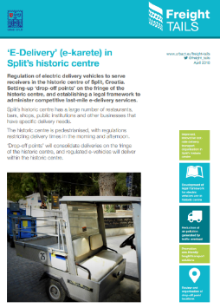
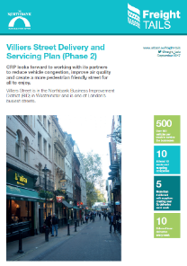
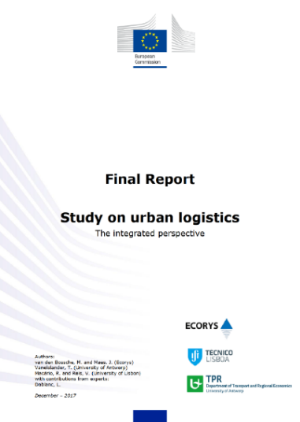
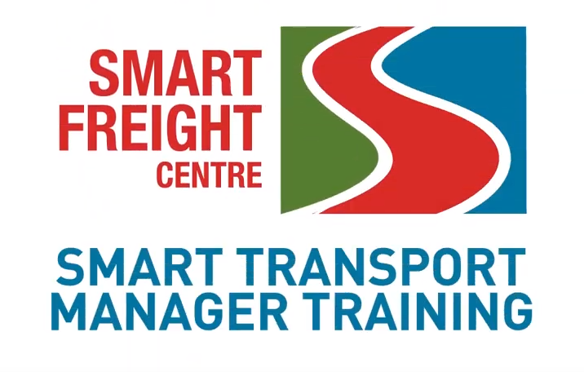
Guidance from experimentation and experience
EU: Sustainable Urban Mobility Plans and Sustainable Urban Logistics Plans
USA: Federal Highway Administration
Increasing evidence from other cities: e.g. London, New York, Seattle
Case studies
Pilots and projects
Online: e.g. SFC Transport Manager
6

Slide 7
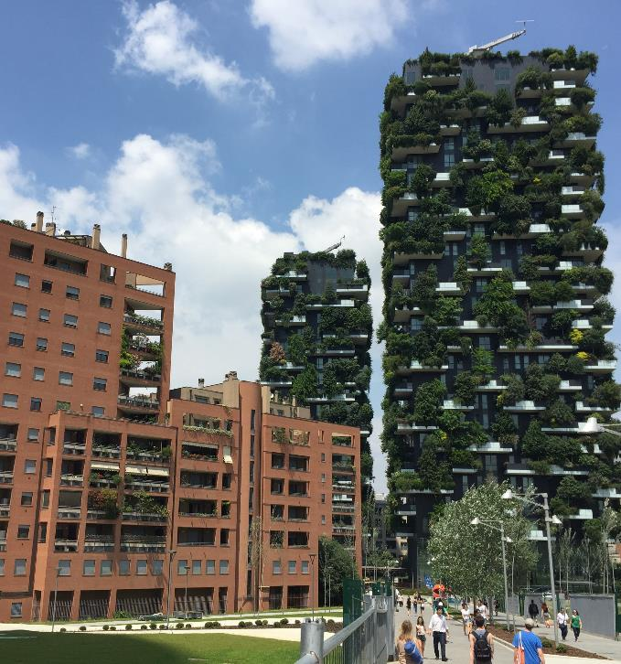


Recognise city outcomes
Reduce emissions
  Air Quality (NOx, SOx, PMs)
  CO₂
Improve safety and liveability
Reduce congestion
Improve economy
Notes:
Beijing. 50% reduction in bad air quality days.
Closing factories using coal and installing gas for domestic users - doubling the price of gas !
Helped by atmospheric conditions

Slide 8
City approach to freight
STRATEGY
SOLUTIONS
Minimise road freight trips | Modal Shift
 | Land Use Planning
 | Consolidation
Match demand to network and location | Retime
 | Re-route
 | Change location
Mitigate impact | Safer
 | Cleaner
 | Quiet
Transport and land use strategy
for
‘people & goods’

Slide 9
Examples
Strategy
Land use
Retime
Safety
9

Slide 10
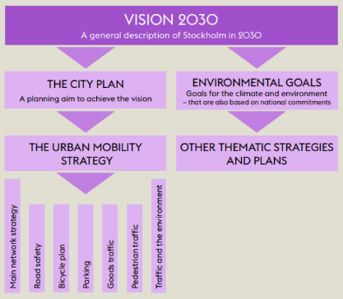

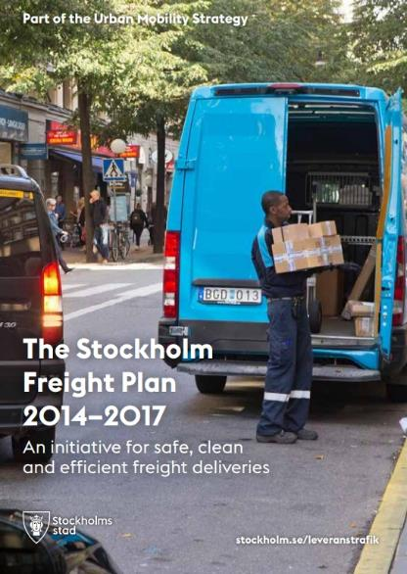
Stockholm (2014)
Vision 2030: Stockholm of the future – what it will be like to visit, inhabit and work in the city
Stockholm City Plan: land use development plan
Urban Mobility Strategy: specific policies to address walking, cycling and public transportation, and the need to accommodate commercial freight traffic
Stockholm Freight Plan (2014 - 2017) four goals:
    To enable more reliable delivery times
    To facilitate commercial freight vehicles by improving access to efficient loading zones
    To promote the use of clean vehicles
    To advance the freight delivery partnership between the City and other stakeholders
  Stockholm Freight Plan (2018 - 2022)
  Plus dedicated resource
Notes:
The Stockholm freight plan (2014) has clear linkages with the higher-level land use and transport planning. Stockholm first developed a city vision, then a city land use plan and subsequently an urban mobility plan.
Vision 2030 and the Stockholm City Plan
Vision 2030 describes the Stockholm of the future – what it will be like to visit, inhabit and work in the city. The Stockholm City Plan supports this vision, and describes how the city will grow and develop.
The Urban Mobility Strategy
The City of Stockholm’s transport plan, the Urban Mobility Strategy, governs the planning of the city’s streets and highways. The strategy contains the policies and proposals to ensure the transport system adapts to meet the vision.
The Plan describes streets from an urban mobility perspective and highlights the importance of streets as attractive places to be. This includes walking, cycling and public transportation, as well as the need to accommodate commercial freight traffic.
The Stockholm Freight Plan (2014) includes four main goals:
To enable more reliable delivery times
To facilitate commercial freight vehicles by improving access to efficient loading zones
To promote the use of clean vehicles
To advance the freight delivery partnership between the City and other stakeholders

Slide 11
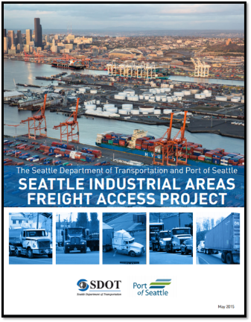
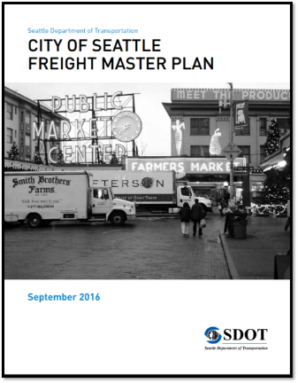
Seattle
Freight Access Project (2015)
  Planned truck-freight infrastructure investment
  Determined requirement for next 20 years
Freight Master Plan (2016)
  Reviewed data relating to past freight action plans, city land use patterns, topography, and traffic volumes
  Identifies key policy and technical issues
Academic partner: University of Washington
  Urban Freight Lab
  Final-50-Feet Research Project
Engagement
Plus dedicated resource

Slide 12
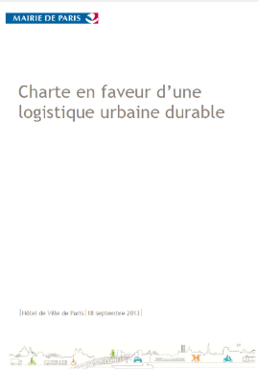
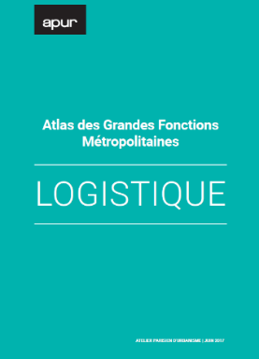
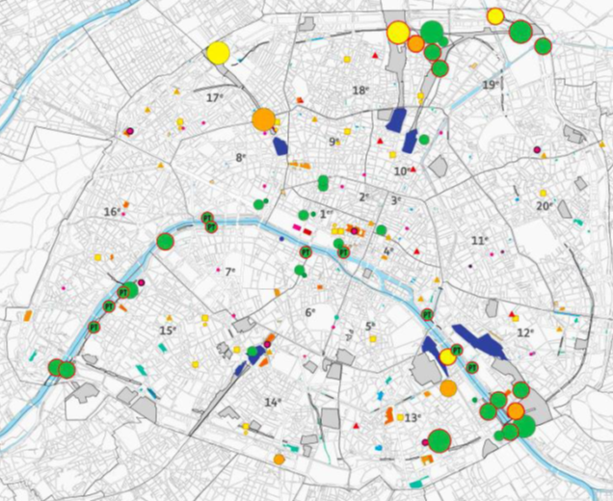
Land use: e.g. Paris
Three types of dedicated logistics space:
Multimodal logistics platform
  Goods in heavy trucks, train or boat
  Preparation of parcels distribution
Cross-dock
  Transfer to ‘last mile’ delivery vehicle (clean energy)
Pick-up
  Collection point/automated lockers
Experimentation and engagement

Slide 13

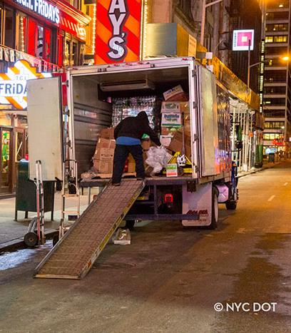
Retimed deliveries: e.g. New York
‘Off hours’ deliveries
Piloted in 2010 with academic support and financial incentives
Focused intervention:
  Deliveries between 19:00 and 06:00
  Midtown and Lower Manhattan
  High pedestrian volumes and limited curb space
Challenge existing regulations
2018: NYCDOT dedicated webpage and ‘exploring incentives’

Slide 14
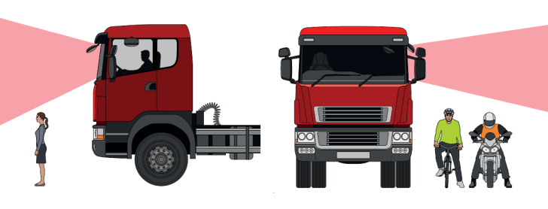

Safer vehicles: e.g. London
Transport for London: safer trucks programme
2015 - 2017: 63% of cyclist and 25% of pedestrian fatalities involved an HGV, despite HGVs making up only 4% of road miles in London
A holistic approach: safer drivers, vehicles and operations
  Safe Urban Driving courses
  Direct Vision Standard
  Freight Operator Recognition Scheme
  Work Related Road Risk (procurement of demonstrably safer operators)
14

Slide 15

Conclusions
Key elements:
Freight vision incorporated in land use and transport strategy, with clear targets
Coordinated approach: ideally across city/urban area, region, nation
Collaboration with stakeholders is not optional: freight is complex and stakeholders have competing needs
There is a need to improve data, tools and modelling, but not at the expense of doing nothing
Need for experimentation and flexibility

Slide 16
Thank you
Ian@futurecitylogistics.com
safer, cleaner and more efficient freight and logistics
http://www.smartfreightcentre.org/

